Slide 1
Working Virtually with Youth: Equity and Access
JAZMIN DANIELSON, 2020

Slide 2
Sources from: U of MN Extension & ACA (American Camp Association)
Ann Nordby, nordby@umn.edu
Kari Robideau, robideau@umn.edu

Slide 3
Topics:
Dos and Don’ts
Choosing tech tools and online activities
Accessing needs through an equity lens

Slide 4
Dos and Don’ts

Slide 5
Don’t
Become overwhelmed by the technology. It's the tool - not the goal.

Slide 6
Don’t
Feel pressured to create tons of online experiences.
The quality will not be good and learners may become overloaded.

Slide 7
Do
Focus on supporting your teacher to create and adapt high-quality activities that serve your learners' needs

Slide 8
Do
Ask your learners or partners what they need. Then come up with a solution that serves them. It may not involve much or any technology. For example, you might decide to send activity sheets with school lunch deliveries.
Remember to make it a high-quality learning experience

Slide 9
Do
Commit to a schedule to support your learners. Then stay in touch with your learners. They are counting on you.
Check on their progress.
Update them on meetings that are scheduled, canceled, moved online, etc.

Slide 10
How to choose tech tools:
Use
Use technology tools that you are comfortable with, that your audience is comfortable with, and that serves your program's teaching goals. Start with your school or organization's in-house tech tools.
Choose
Choose technology tools that align with your program's pedagogical principles and that take a positive youth development approach.
Consider
Consider going low-tech. Kids will appreciate hearing from you, and a note in the school lunch delivery or a letter in the mail may mean more to them than an email.

Slide 11
Choosing online activities: Consider these questions
Are these the kinds of activities that our youth program or classroom ordinarily do?
What will learners learn by doing this activity? Does that match up our teaching goals?
Would the youth in my program enjoy it?
Does it require families to buy anything? If it does, seek out activities that use only materials found in nature or in most households.
Consider screen time: Have learners already spent the entire day looking at a screen? How will our learning experience include active learning and be different from formal education strategies?

Slide 12
Digital Divide: By Ed Trust-West (Education Equity in Crisis)
A recent study found that, nationally, around 17% of children are unable to complete their homework due to limited internet access. This “digital divide” and often resulting “homework gap” mirrors trends in California, where about 1 in 6 school-aged children lack access to the internet at home.

Slide 13
The equity implications of these gaps and impacts on learning have been brought into sharper focus as schools and districts across the state grapple with the COVID-19 crisis. Our parent poll revealed that 38% of low-income families and 29% of families of color are concerned about access to distance learning because they don’t have reliable internet at home. Parents also cited concern about access to technology – 50% of low-income and 42% of families of color lack sufficient devices at home to access distance learning.

Slide 14
Internet Access in MN Minnesota Department of Employment and Economic Development and Connected Nation, 2019.

Slide 15
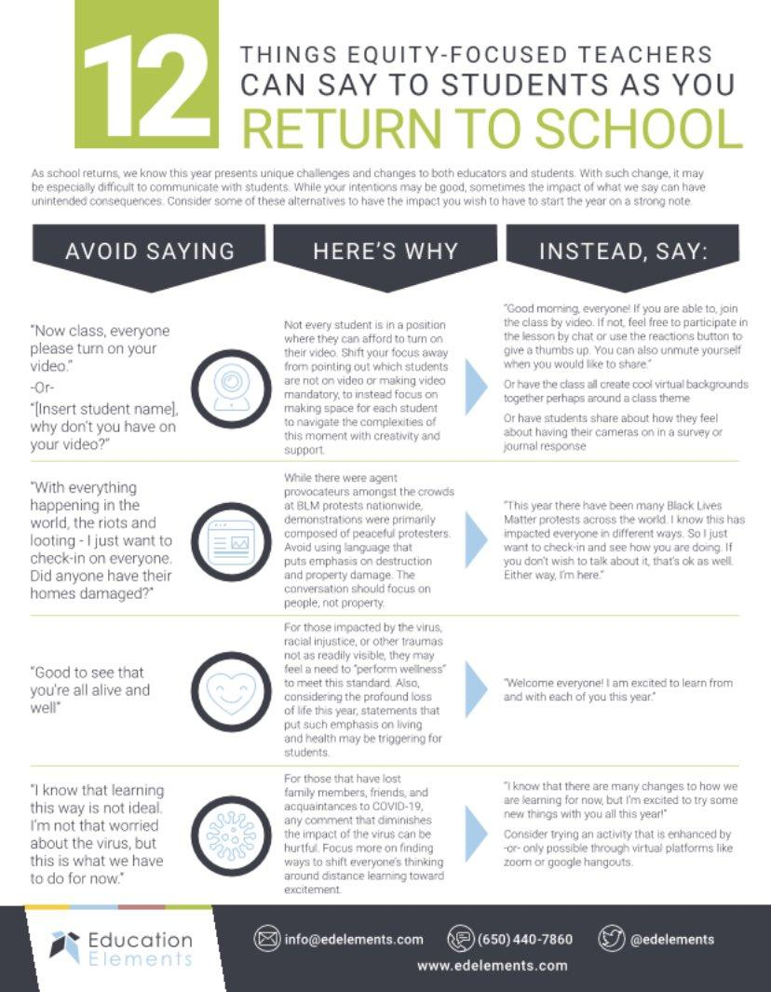
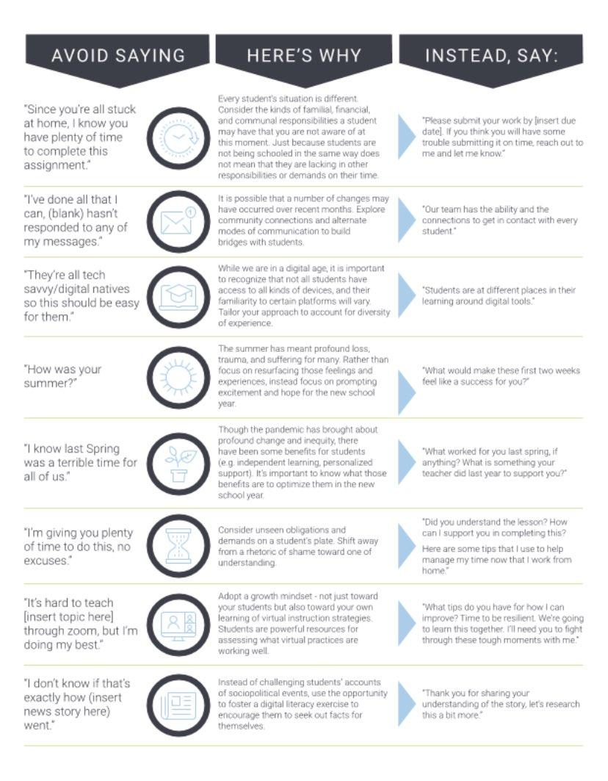

Slide 16
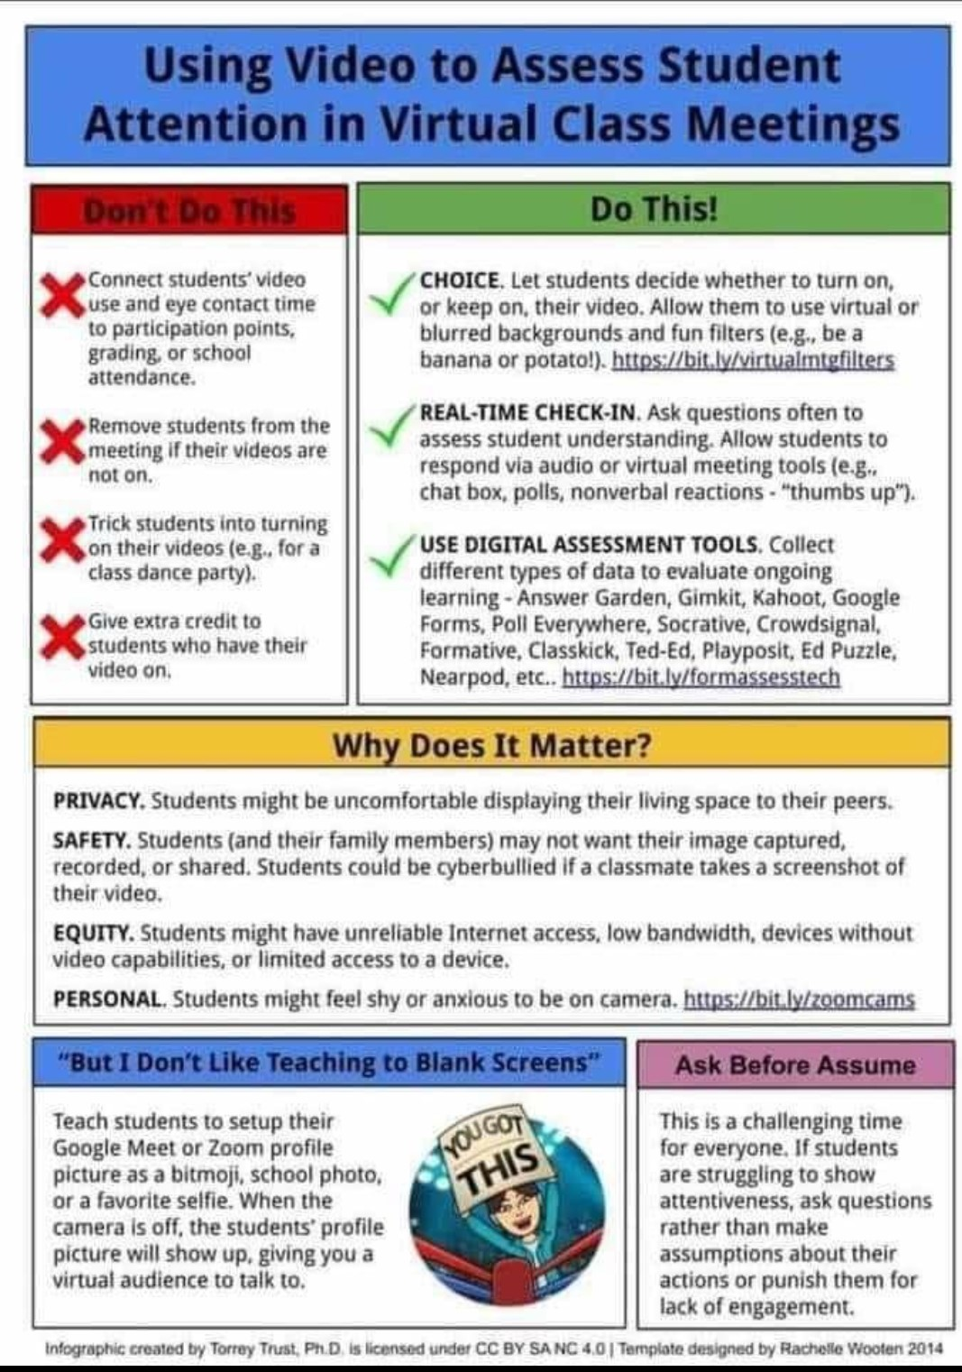
Provide students with
Power and choice!
Students have little power right now. Finding ways to give students opportunities to make decisions about their own learning helps to combat that.
Authentic interest in the social and emotional well being!
Students and adults are experiencing trauma and grief through the COVID19 pandemic. Give kids opportunities to connect with you and each other that allow them to be their full selves.
Other means of showing you how they learn.
If a student keeps their camera off during class, what other ways can they demonstrate their learning? Provide multiple options!

Slide 17
Provide Virtual Brain Breaks
Have students stand, move and wiggle in front of and away from their screens.
Provide opportunities to have ‘virtual recess’ so that kids can just hang out and be silly together.

Slide 18
Supporting racial equity and people with disabilities in distant learning
https://mneep.org/toolkit/distance_learning/
MN Education Equity Partnership
https://www.arts.gov/accessibility/accessibility-resources/resources-to-help-ensure-accessibility-for-your-virtual-events-for-people-with-disabilities
National Endowment for the Arts
https://www.mncompass.org/trends/insights/2019-08-27-three-questions-about-internet-access
MN Compass

Slide 19
Your Distance Learning Work with Youth:
What is your school/program intentionally doing to ensure access to your virtual program?
What is your school/ program doing to be intentionally inclusive?
What is your school/ program doing to ensure an equitable virtual experience among the youth participants?

