Slide 1
Making Remote and Online Learning Accessible and Flexible
Ariel Gunn
agunn@ufl.edu

Slide 2
Questions
Many of the people joining us today do in person education and programing for youth. What are some foundational differences for online learning/programing?
What considerations should we be making for pedagogy practices for online programs/education in order to provide the best experiences for the participants or learners?
When providing online education and programing what should we consider in order to make sure online environments are accessible for learners or participants?

Slide 3
UDL Guidelines (CAST)

Slide 4
UDL Resources
http://udlguidelines.cast.org/
Local instructional designers, curriculum developers, or faculty developers

Slide 5
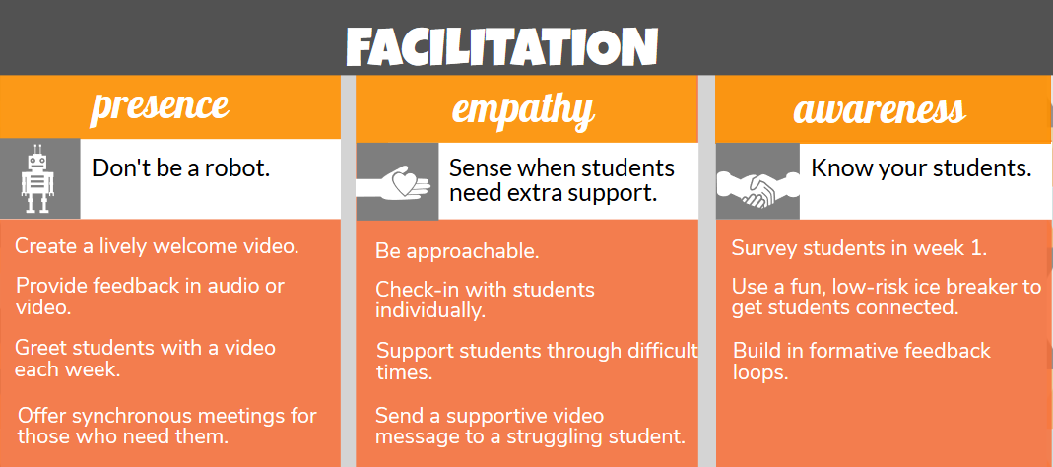
Humanizing online learning: Facilitation

Slide 6
Humanizing Online Learning: Course Design

Slide 7
Humanizing Online Learning
https://brocansky.com/
Talk to your local instructional designers, curriculum developers, or faculty developers for best practices in online and remote teaching and learning

Slide 8
Top Accessibility Tips

Slide 9
Accessibility Resources
Adobe (videos and web pages dedicated to PDF accessibility)
LinkedIn Learning (free for UF faculty/staff/students; search “accessibility”)
Google Accessibility
Microsoft Office Accessibility Center
VPAT (Voluntary Product Accessibility Template)
WebAIM (popular for its Color Contrast Checker and simulations)
Web Content Accessibility Guidelines (WCAG)

Slide 10
Common Sense Education: Tools w/ Sound Privacy Practices
Adobe Spark EDU*
Book Creator
BrainPop
ClassDojo*
Code.org*
DreamBox Learning Math
Edulastic*
FlipGrid*
Formative*
Khan Academy*
LearnZillion*
PBS Kids*
Pear Deck*
Remind*
Seesaw: The Learning Journal*
ThinkCERCA
Zearn*
*=free

Slide 11
Digital Tool Resources
https://www.commonsense.org/
http://page.teachingwithoutwalls.com/tool-buffet
https://teachingwithemergingtech.com/
Talk to local instructional designers or IT department for list of free or low-cost tools approved by your institution

Slide 12
Local Resources
Instructional designers, educational technologists, or academic technology specialists
Disability Resource Center
Librarians
College of Ed faculty and students
Teaching and learning centers
IT (privacy and security)

Slide 13
Online Resources
Universal Design
CAST Universal Design for Learning
Center for Excellence in Universal Design
How to Humanize your Online Class
Digital Accessibility
Adobe (videos and web pages dedicated to PDF accessibility)
LinkedIn Learning (free for UF faculty/staff/students; search “accessibility”)
Google Accessibility
Microsoft Office Accessibility Center
VPAT (Voluntary Product Accessibility Template)
WebAIM (popular for its Color Contrast Checker and simulations)
Web Content Accessibility Guidelines (WCAG)
Digital Tools
Common Sense Education (edtech tool reviews, including privacy and data security rating)
Teaching with Emerging Technology (tool and tech reviews with best practices)

Slide 14
Universal Design
Creating equitable access for diverse users

Slide 15
Who is your audience?
No “typical” learner
Age, expert vs novice, environment, access, ability
Visual impairment → magnifier
Blind →screen reader
Physical impairment → keyboard navigation
Dyslexia or other cognitive disability → ability to customize font or background color
Notes:
Most things are often designed for an average or typical user, but often there is no such person! When I work with faculty, I remind them that their idea of a “student” may not be accurate, and I imagine this is similar for all of you. They may be learning their ABCs or high schoolers or retirees, a professor emeritus or curious reader, reading in a quiet library or loud bus, have excellent wifi or none at all. Your audience may have a variety of abilities that require unique assistive technology. SEE SLIDE

Slide 16
How can diverse needs be met?
Take a universal design approach
Equitable design suitable for audience with diverse abilities
Flexible and customizable
Designed with assistive technologies in mind
Notes:
Taking a universal design approach allows you to identify equitable design options for your audience. Taken from the world of architecture, universal design is predicated on the idea of diversity and equity and it emphasizes flexibility and accessibility.

Slide 17
Five Tips for Digital Accessibility
Minimizing barriers, one document at a time!

Slide 18
Designing Accessible Documents
Describe images
Choose color carefully
Make text readable
Apply structure to your text
Provide flexibility in format

Slide 19
Tip# 1: Describe images

Slide 20
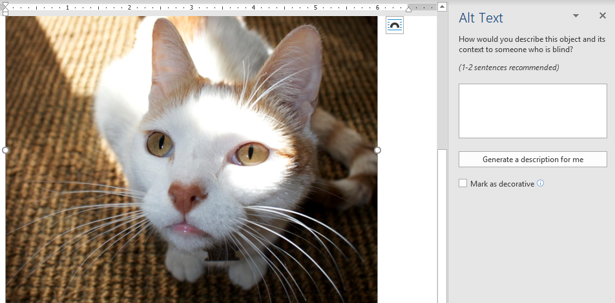
Ways to Describe Images
Describe image in written text
Summarize content
Highlight important/relevant details
Insert alternative (alt) text
Critical for those who use screen readers
Easy to add!

Slide 21
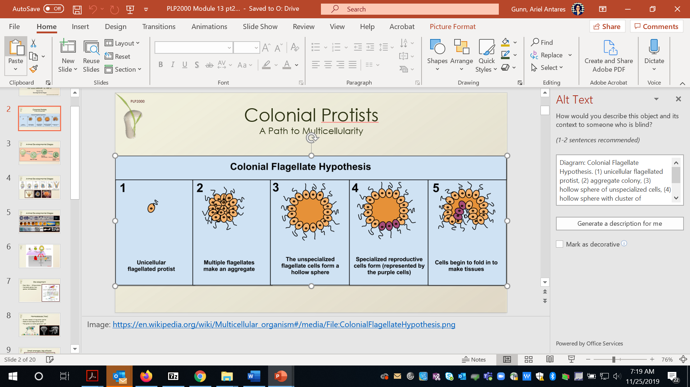
Writing Good Alt Text
WebAIM Recommendations
Be accurate and equivalent
Be succinct (but consider context)
Avoid redundancy
Avoid the phrases "image of ..." or "graphic of ..." to describe the image
Exception: when the format of the image is relevant

Slide 22
Decorative Images
What does decorative mean?
Visual styling (e.g., borders)
Illustration of text or content but not contributing information (“eye-candy”)
Identified and described by surrounding text
What do to?
Mark as decorative or leave alt text blank
Do an image audit

Slide 23
Tip #2: Provide Text Alternatives for Audio/Video

Slide 24
Ways to Provide Text Alternatives
Captions
Text appears within video
Submit request to UFIT (accessibility.ufl.edu)
Do it yourself with YouTube
Script
Text version
Write in advance and provide for download
Transcript
Includes time stamps and speaker changes
Some tools provides auto transcription that you can edit for accuracy

Slide 25
Tip# 3: Choose Color Carefully

Slide 26
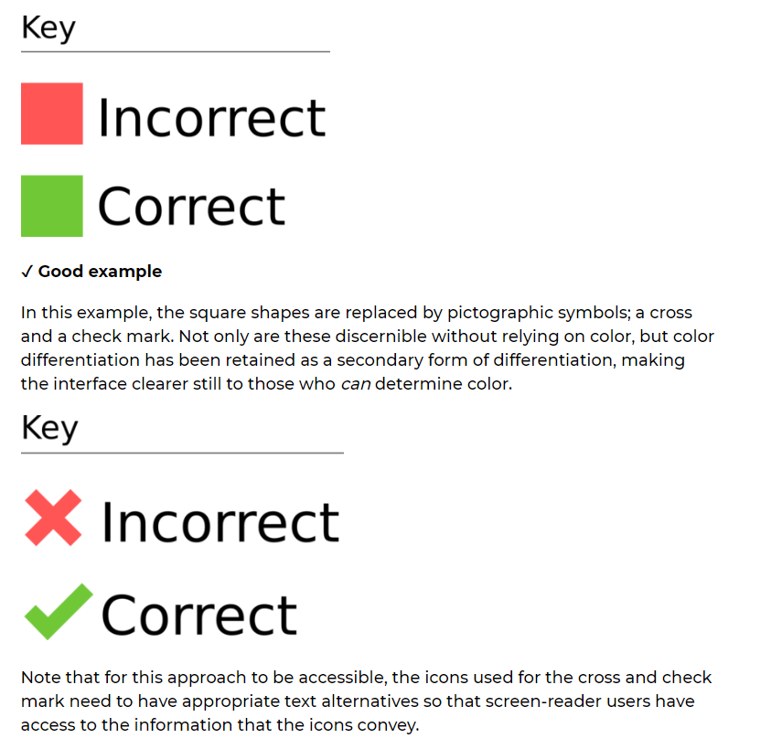
Color to Convey Meaning
Avoid color alone to convey meaning
Doesn’t translate to users with color deficit or those who use a screen reader
Find additional ways to convey the information
Source: Digital Accessibility, Harvard University
Notes:
Example here provides a way to use both color, text, and icons. There would also be alt text.

Slide 27
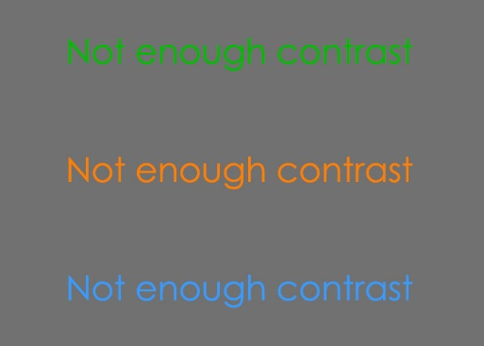
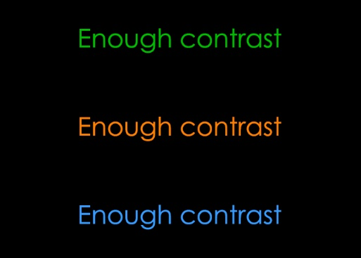
Color Contrast
Ensure adequate color contrast between text and background
Notes:
Another tip is to ensure high color contrast between the text and background. Here you can see an example where the font and the background have a low contrast ratio. And here is an example where the contrast is more pronounced.

Slide 28
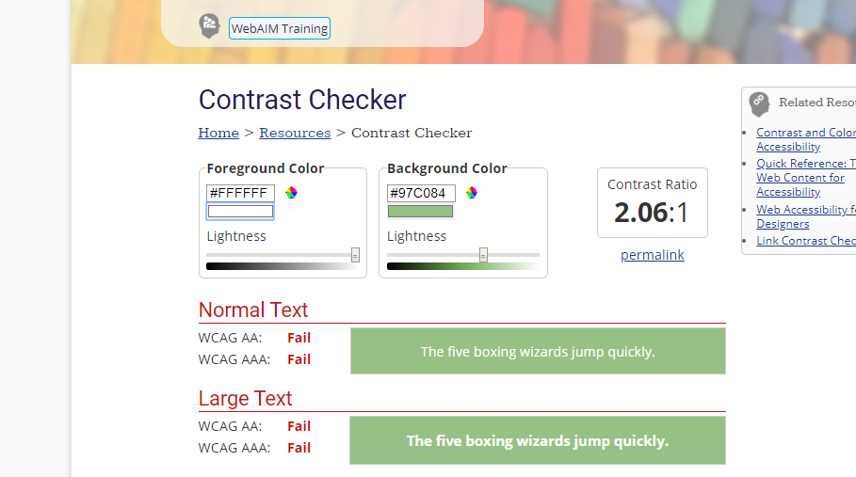
Color Contrast Checker
WebAIM
Aim for 3.0 ratio (minimum)
Source: webaim.org/resources/contrastchecker/
Notes:
WebAIM provides an easy-to-use color contrast checker. You can access the tool by going to webaim.org. Here you can see that the color contrast is too low to be accessible. A minimum ratio is 3.0, but higher is better.

Slide 29
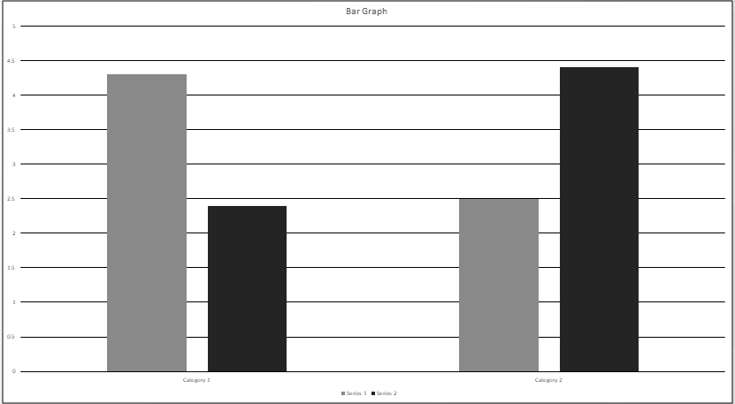
Color Combination Example
Color combinations especially important in charts and graphs
Use grey scale as a quick check
Notes:
Additionally, for things like graphs, you will want to consider color combinations. Since there are different kinds of color blindness, it’s helpful to look at your colors in grayscale to see if they can be distinguished from one another or use a website that allows you to simulate different kinds of color blindness.

Slide 30
Tip #4: Keep Text Readable

Slide 31
Font Type and Size
Select font type for readability
Simple, sans Serif fonts for text (Calibri or Arial)
Serif fonts for headings or titles
Ensure font size is large enough
Documents = 12 – 14 pt
Notes:
When choosing fonts for small text or large chunks of type, we recommend simple, sans Serif fonts like Calibri or Arial. Serif fonts are more appropriate for adding visual appeal to large text like a title. Some users may benefit from specialty fonts like those made for people with Dyslexia. Text should not be too small to read easily: A good rule is no smaller than 12 pts for Word documents, though exceptions can be made if a document is able to be easily magnified.

Slide 32
Tip #5: Apply Structure to your Text
Notes:
Applying structure by using styles can enhance readability for all users, and in particular can make material more usable for those who use screen readers or keyboard navigation.

Slide 33
Use Heading and List Styles
Use provided styles for headings and lists
Promotes overall readability
Allows learners who use screen readers or keyboard navigation
Notes:
Using styles visually break up blocks of text, which promotes overall readability and also allows people who use screen readers or keyboard navigation to more easily skim and jump between sections. You can edit the styles to look different; just make sure they maintain the style designation.

Slide 34
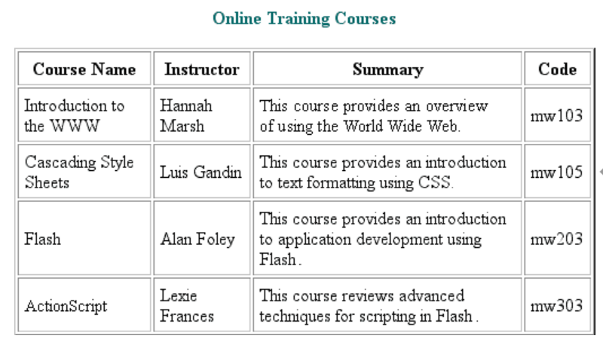
Format Tables
Identify row and column headers
Associate data cells with appropriate headers
Add table captions or alt text
Source: Adobe
Notes:
Formatting tables to be accessible for a screen reader can be tricky. At minimum, add a table caption or alt text can

Slide 35
Embed URLs in Descriptive Text
Allows the screen reader to read the text, not the URL
Read Plagiarism—A Complex Issue
Read https://www.tandfonline.com/doi/pdf/10.1080/02602930500266
Exceptions: when content is intended for print
Notes:
Finally, another tip for accessibility in digital material is to embed URLs in descriptive text. This ensures that the screen reader won’t read the URL. Which do you prefer: Read Plagiarism—A Complex Issue or Read http://www.tandfoline.... OK. You get the idea.

Slide 36
Bonus Tip: Provide Flexibility in Format

Slide 37
Which Format is Most Accessible?
No easy answer (it depends)
PDFs not automatically accessible
Balancing appearance with flexibility
Notes:
There is no automatically accessible document type. All require the formatting to ensure that they work with assistive technology. PDFs are often touted as the most accessible option, but I think we have conflated its portability with accessibility. Because most content creators, teachers, editors, and other professionals are sighted or don’t require the use of assistive technology, we often privilege appearance over flexibility. Finding a balance is key.

Slide 38
Is a PDF the Best Choice?
Can you answer YES to at least 1 of these questions?
Was the document created in software many won’t have?
Does your document require
precise formatting?
non-standard fonts or special characters?
formulas or equations?
Is document large?
Is it intended for print?
Notes:
Likely you’re already using PDFs, because they do have benefits. When I help faculty decide whether a PDF is the right choice for them, I ask them how they can answer these questions.

Slide 39
Alternative Format Options
Native Microsoft format
All UF faculty, staff, and students have access to Microsoft Office products (Word or PowerPoint)
html
More responsive to screen size and can limit scrolling
ebook formats (EPUB, EPUB3, Mobi)
Alternate media
audio file (MP3)
digital Braille
Notes:
Taking a universal design approach means that we also think about providing flexibility, which might mean exploring alternative format options, including a native Microsoft document, html, ebook, or alternate media like audio or digital Braille.

Slide 40
Bonus Tip: Use Accessibility Tools!

Slide 41
Accessibility Tools Available
Accessibility tools available for
Microsoft Word
Microsoft PowerPoint
PDFs in Adobe
E-Learning (Canvas)
Common accessibility issues identified
missing alt text, color contrast, reading order, heading structure

Slide 42
The Future is Accessible!

Slide 43
Resources

Slide 44
Thank you! Questions? Email me agunn@ufl.edu

Slide 45
References
Harvard University, Digital accessibility. https://accessibility.huit.harvard.edu/%E2%9C%8E-technique-colored-pictograms
WebAIM, Color contrast checker. https://webaim.org/resources/contrastchecker/
Adobe, Accessible tables. https://www.adobe.com/accessibility/products/dreamweaver/tables.html

